Slide 1

Text Summarization using PEGASUS Transformer
Presented by-
Tarak Ram Nunna

Slide 2
Abstract:
Pre-training Transformers with self-supervised objectives on large text corpora has shown great success when fine-tuned on downstream NLP tasks including text summarization
However, pre-training objectives tailored for abstractive text summarization have not been explored. This work proposes pre-training large Transformer-based encoder-decoder models on massive text corpora with a new self-supervised objective.

Slide 3
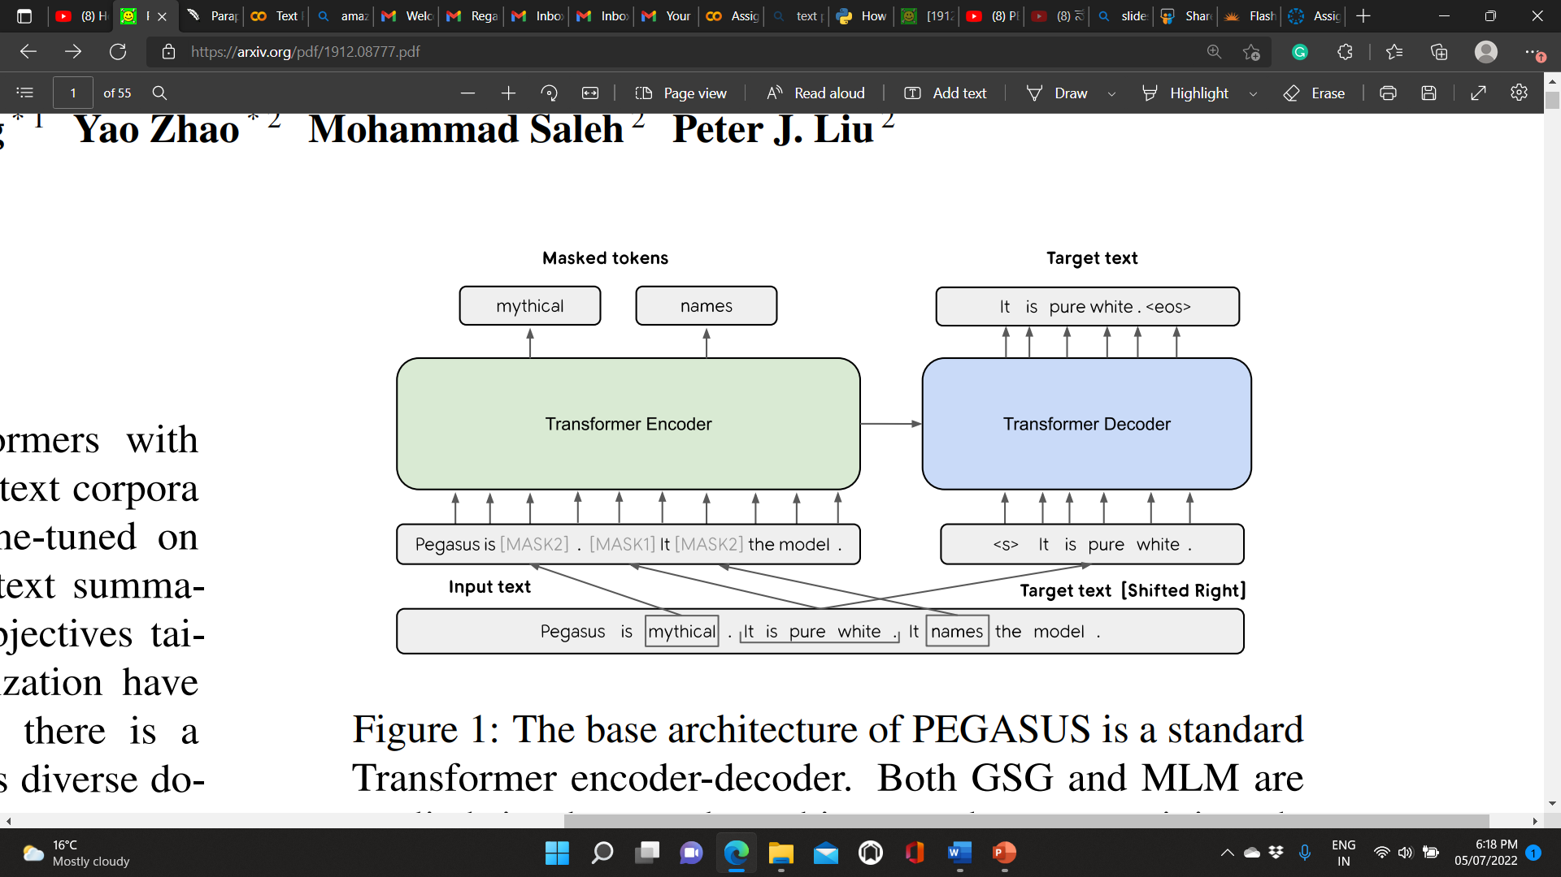
Architecture:
Figure: The base architecture of PEGASUS is a standard Transformer encoder-decoder

Slide 4
Both GSG and MLM are applied simultaneously to this example as pre-training objectives. Originally there are three sentences. One sentence is masked with [MASK1] and used as target generation text (GSG). The other two sentences remain in the input, but some tokens are randomly masked by [MASK2] (MLM).
Figure 1 simultaneously shows how both GSG and MLM are applied to the same example when used in conjunction.
We apply MLM to train the Transformer encoder as the sole pre-training objective or along with GSG.
When MLM is the sole pre-training objective, the Transformer decoder shares all parameters with the encoder when fine-tuning on downstream tasks following Raffle et al.
we found that MLM does not improve downstream tasks at a large number of pre-training steps, and chose not to include MLM in the final model PEGASUS

Slide 5
Introduction
PEGASUS: Pre-training with Extracted Gap-sentences for Abstractive SUmmarization Sequence-to-sequence models.
Important sentences from an input text are removed/masked in PEGASUS, and the remaining sentences are formed as one output sequence from the remaining sentences, similar to an extractive summary.
An example input for pre-training is a document with missing sentences, while the output consists of the missing sentences concatenated together.

Slide 6
Pre-training Datasets
C4, or the Colossal and cleaned version of Common Crawl, introduced in Raffel et al. (2019); consists of text from 350M web pages (750GB).
Huge News, a dataset of 1.5B articles (3.8TB) collected from news and news-like websites from 2013 to 2020. A whitelist of domains ranging from high-quality news publishers to lower-quality sites such as high-school newspapers and blogs were curated and used to see a web crawler. Heuristics were used to identify news-like articles, and only the main article text was extracted as plain text.

Slide 7
Downstream Abstractive Summarization Datasets
In addition to exploring the huge news datasets for pre-training, PEGASUS is going to explore a lot of different downstream abstractive summarization datasets.
List of Downstream Abstractive Summarization Datasets:
Xsum
CNN/DailyMail
NEWSROOM
Gigaword
orXiv, PubMed
BIGPATENT
WikiHow
Reddit TIFU

Slide 8
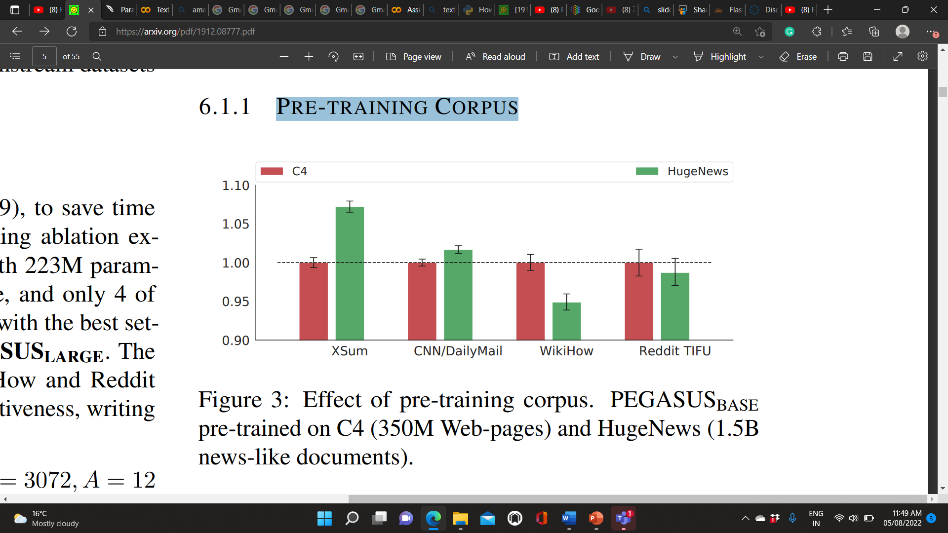
PRE-TRAINING CORPUS
Graph shows that pre-training on HugeNews was more effective than C4 on the two news downstream datasets, while the non-news informal datasets (WikiHow and Reddit TIFU) prefer the pre-training on C4. This suggests pretraining models transfer more effectively to downstream tasks when their domains are aligned better.

Slide 9
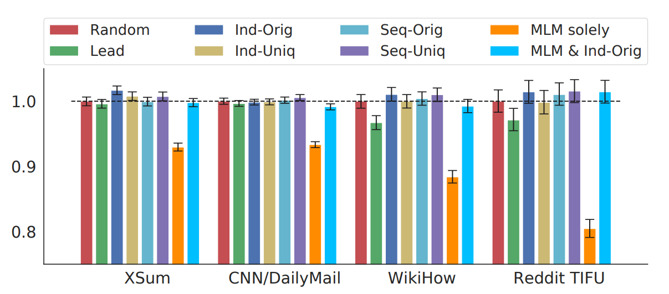
EFFECT OF PRE-TRAINING OBJECTIVES
We compared six variants of GSG (Lead, Random, Ind-Orig, Ind-Uniq, Seq-Orig, Seq-Uniq) while choosing 30% sentences as gap sentences. As shown in graph, IndOrig achieved the best performance followed by Seq-Uniq. Ind-Orig and Seq-Uniq were consistently better (or similar) than Random and Lead across the four downstream datasets

Slide 10
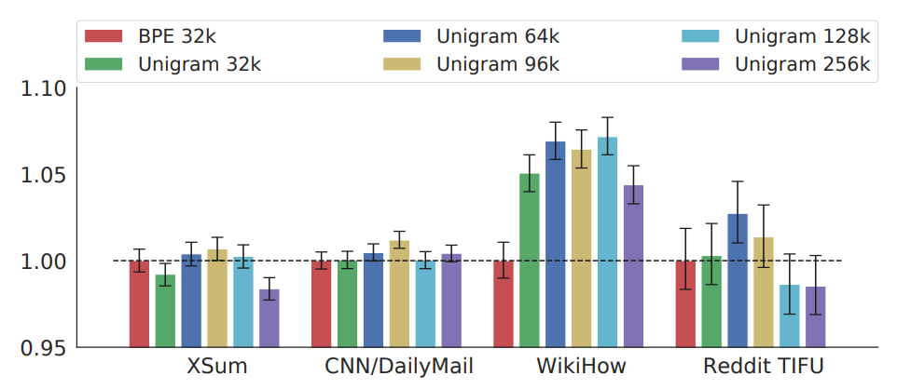
EFFECT OF VOCABULARY
We compared two tokenization methods: The byte-pair encoding algorithm (BPE) and the SentencePiece Unigram algorithm (Unigram). We evaluated Unigram with different vocabulary sizes ranging from 32k to 256k. In these experiments, models were pre-trained for 500k steps on the C4 corpus with the Ind-Orig objective and 15% GSR.

Slide 11
Conclusions
In this project, we proposed PEGASUS, a sequence-to-sequence model with gap-sentences generation as a pretraining objective tailored for abstractive text summarization.
We studied several gap-sentence selection methods and identified principle sentence selection as the optimal strategy. We demonstrated the effects of the pre-training corpora, gap-sentences ratios, and vocabulary sizes and scaled up the best configuration to achieve state-of-the-art results on all 12 diverse downstream datasets considered.
We also showed that our model was able to adapt to unseen summarization datasets very quickly, achieving strong results in as little as 1000 examples.
We finally showed our model summaries achieved human performance on multiple datasets.

Slide 12


